Slide 1

EMT Just In Time Training Modules, COVID-19
Familiarizing the staff with the disease and its implications

Slide 2

Session Outcomes
Outline the main features of the SARS-CoV-2 pandemic
Distinguish between facts and myths in relation to the disease
Outline the personal consequences for EMT staff involved in combating the disease
Identify the potential roles of EMTs in managing the disease within communities

Slide 3

Pairs Exercise

Slide 4
COVID-19 Key Facts
Virus
Droplet transmission
Incubation period
Infectious period

Slide 5
Categories of severity
With risk factors
No risk factors

Slide 6
Key Problems
No treatment and no vaccine available
Only preventive measures and supportive treatment options
Overwhelmed resources
Numbers of infected and mortality are reported inconsistently
Different testing policies exist within and between countries
Politicization of the response

Slide 7

Group Exercise
1st column: gaps
2nd column: contributions
3rd column: challenges
4th column: tools, techniques & further training

Slide 8
Roles that EMT personnel are playing
Establishment, or support to, temporary hospitals
Community treatment centres or other pre-hospital activities
Surge staffing to overwhelmed facilities
Provision of equipment and operational support
Provision of training for staff and management of existing health facilities
Support to local or national health authorities in non-service delivery roles (e.g. advice on coordination or technical issues)

Slide 9
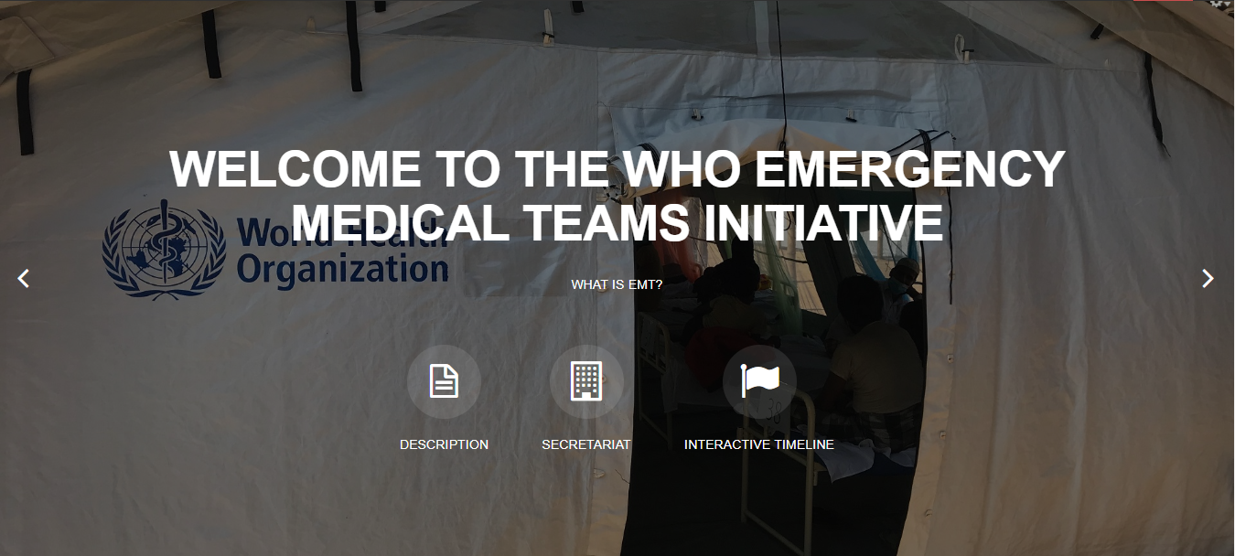
Thank you
Any questions?
For more…
http://extranet.who.int/emt/
EMTeams@who.int

